Slide 1
Input and Output Operations
Unit 3

Slide 2
Data Input and Output
A program without any input or output has no meaning.
Input → process → Output
Ex. marks sheet of students
Reading the data from input devices and displaying the result are the two main tasks of any program.

Slide 3
Input/output functions are the links between the user and the terminal.
Input functions are used to read data from keyboard are called standard input functions.
scanf(), getchar(),getche(),getch() etc.
Output functions are used to display the result on the screen are called standard output functions.
printf(), putchar(), putch(), puts() etc.

Slide 4
In C, the standard library stdio.h provides functions for input and output.
The instruction #include<stdio.h> tells the compiler to search for a file named stdio.h and places its contents at this point in the program.
The contents of the header file become part of the source code when it is compiled.

Slide 5
The input/output functions are classified into two types –
Formatted functions
Unformatted functions

Slide 6
Formatted Functions
Formatted functions allow the input read input from the keyboard or the output displayed on screen to be formatted according to our requirements.
Input function: scanf()
Output function: printf()

Slide 7
Formatted Input
Ex: consider the following data:
50, 13.45, Ram
Int, float, char variables
This is possible using the scanf function.
scanf stands for scan formatted.
The built-in function scanf() can be used to enter input data into the computer from a standard input device.

Slide 8
The general form of scanf is,
scanf(“control string” , arg1, arg1,….. argn);
Control string→ format in which data is to be entered.
arg1,arg2… → location where the data is stored.
→ preceded by ampersand (&)

Slide 9
The control string consists of individual groups of data formats, with one group for each input data item.
Each data format must begin with a percentage sign.
General form of control string:
[whitespace character][ordinary character]%[field width] conversion character
Whitespace characters [optional]
Ordinary characters [Optional]
Field width [Optional]

Slide 10
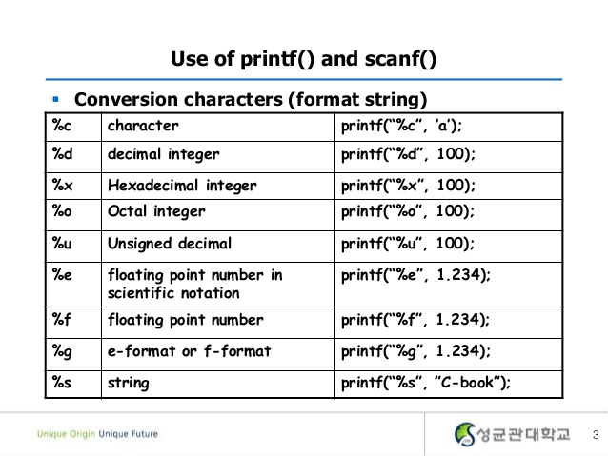

Slide 11
#include<stdio.h>
#include<conio.h>
void main() // Whitespace characters example
{
int n1;
char ch;
clrscr();
printf("Enter a number: ");
scanf(“ %d",&n1);
printf("Enter a character: ");
scanf(“ %c",&ch);
printf("\nNumber: %d \t Character: %c",n1,ch);
getch();
}

Slide 12
#include<stdio.h>
#include<conio.h>
Void main(){ // Ordinary characters
Int day,year,month;
clrscr();
printf(“enter day month year in DD-MM-YYY format”);
scanf(“%d-%d-%d”,&day,&month,&year);
getch();
}

Slide 13
#include<stdio.h>
#include<conio.h>
void main(){ //Field width example
int d;
printf(“Enter Max 5 numbers”);
scanf(“%5d”,&d);
printf(“Entered Numbers: %d”,d);
getch();
}

Slide 14
#include<stdio.h>
#include<conio.h>
void main(){ //Input String
char string[10];
printf(“Enter Your Name”);
scanf(“%s”,string);
printf(“Your Name is %s”);
getch();
}

Slide 15
#include<stdio.h>
#include<conio.h>
void main(){
char string[10];
printf("Enter Your Name:");
scanf("%s",string);
printf("My Name is %s",string);
getch();
}

Slide 16
some versions of scanf() support the following conversion specifications for strings:-
%[character]
only characters specified within the brackets are allowed in the input string.
%[^character]
the character specified after the caret are not allowed

Slide 17
#include<stdio.h>
#include<conio.h>
void main(){
char string[10];
printf("Enter Your Name in uppercase:");
scanf("%[A-Z]",string);
printf("Your Name is %s",string);
getch();
}

Slide 18
#include<stdio.h>
#include<conio.h>
void main(){
char string[10];
printf("Enter Your Name:");
scanf("%[^\n]",string);
printf("My Name is %s",string);
getch();
}
%[^\n] tells the compiler to read a string until a newline character is entered

Slide 19
Reading Mixed Data Types
printf(“enter an integer, floating number, gender and name:”);
scanf(“%d %f %c%s”,&i,&n1,&gender,&name);
scanf() can contain mixed mode data.
care should be taken to ensure that the input data items match the control specification.

Slide 20
Formatted Output
refers to the output of data that has been arranged in a particular format.
printf() is a built in function which is used to output data from the computer onto a standard device i.e. screen
General form:
printf(“control string”,arg1,arg2,.....,arg n)
The control string consists of four types of items -
characters that will be printed on the screen as they appear.
format specifications that define the output format for display of each item
escape sequence characters such as \n, \t etc.
any combination of characters, format specifications and escape sequences.

Slide 21
The control string has the form:
%[flag] [field width][.precision] conversion character
Flags [optional]
“ – “ indicates data item to be left-justified
“+” indicates a positive or negative sign to precede
“0” indicates leading 0’s to appear instead of leading blanks
Field width[optional]
Same as before
Precision [optional]
The operation of precision field depends on the type of conversion. It must start with a period (.).

Slide 22
Unformatted Functions
Doesn’t allow user to read or display data in desired format.
These library functions basically deals with a single character or a string of characters.
The functions getchar(), putchar(), gets(),puts(),getch(),getche(),putch() are considered as unformatted functions.

Slide 23
getchar()
Reads a character from a standard input device.
It takes the form:
Character_variable= getchar();
Character_variable is a valid C char type variable.
When this statement is encountered, the computer waits until a key is pressed and then assigns this character to character_variable.

Slide 24
putchar()
Displays a character to the standard output device.
Its form:
putchar(character_variable);
Where character_variable is a char type variable containing a character

Slide 25
Void main(){
char gender;
clrscr();
printf(“Enter gender M or F”: );
gender=getchar();
printf(“Your Gender is: “);
putchar(gender);
getch();
}

Slide 26
getch() and getche()
Reads single character the instant it is typed without waiting for the enter key to be hit.
getch() doesn’t print the character entered
getche() displays the character when entered.
General form
character_variable=getch();
character_variable=getche();
In both functions, the character typed is assigned to the char type variable character_variable.

Slide 27
putch()
The function putch() prints a character onto the screen
General form
putch(character_variable);
Character variable is a char type.
NOTE: These three functions are defined under the standard library functions conio.h

Slide 28
void main(){
char ch1, ch2;
clrscr();
printf("Enter 1st character: ");
ch1=getch();
printf("\n Enter 2nd character");
ch2=getche();
printf("\n first character: ");
putch(ch1);
printf("\nSecond character: ");
putch(ch2);
getch();
}

Slide 29
gets()
Used to read string of text, containing whitespaces, until a new line character is encountered.
General form
gets(string_variable);
puts()
Used to display the string onto the terminal
General form:
puts(string_variable);

Slide 30
void main()
{
char name[20];
clrscr();
printf("Enter your name:");
gets(name);
printf("Your Name is: ");
puts(name);
getch();
}

Slide 31
END

